Slide 2
Pre-Training and Post-Training
Sample ID | Location | SOC content (%) | Mineral | Mucky Mineral | Organic
1 | NH
2 | RI
3 | MA
4 | MA
5 | RI
6 | MA
7 | NH
8 | MA
9 | RI
10 | MA
the same 11 people participated in both pre and post

Slide 3
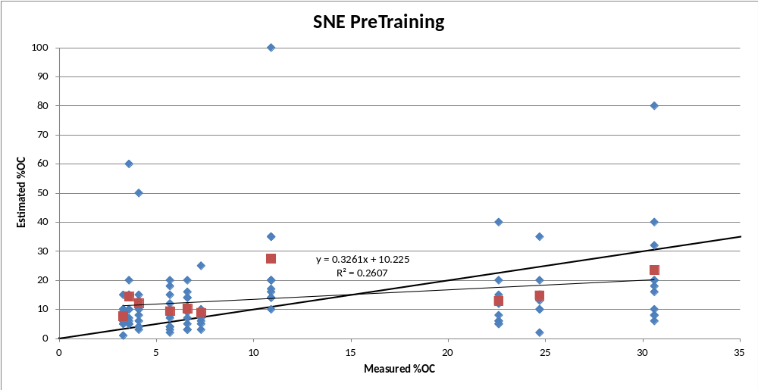

Slide 4
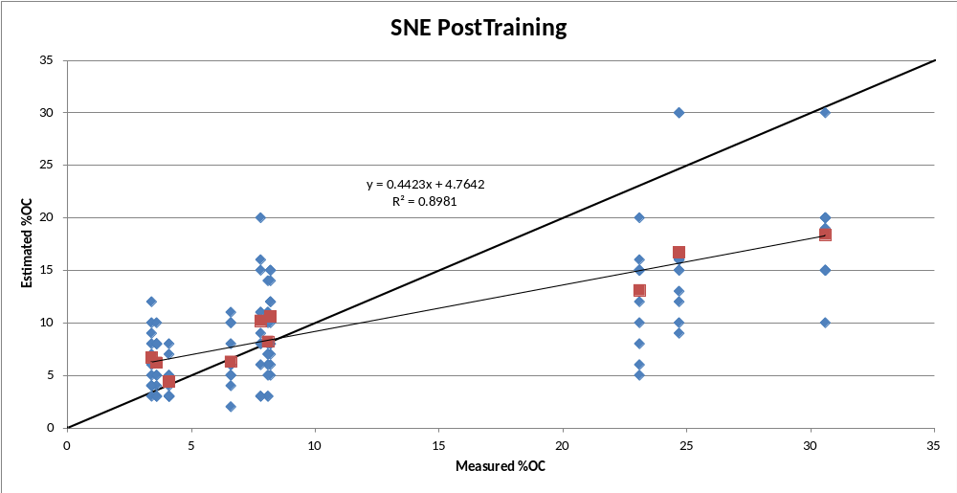

Slide 5
New England Class Assignment Results
Participant | A | B | C | D | E | F | G | H | I | J | K | correct
Pre-training Correct | 6 | 5 | 6 | 3 | 3 | 4 | 4 | 5 | 3 | 2 | 4 | 41%
After training Correct | 7 | 8 | 5 | 5 | 6 | 10 | 5 | 7 | 7 | 7 | 8 | 68%
Individual Improvement | 10 | 30 | -10 | 20 | 30 | 60 | 10 | 20 | 40 | 50 | 40

Slide 6
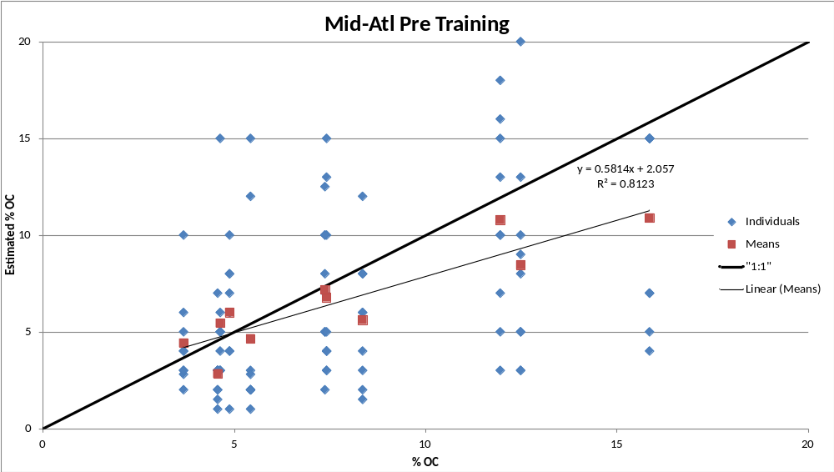

Slide 7
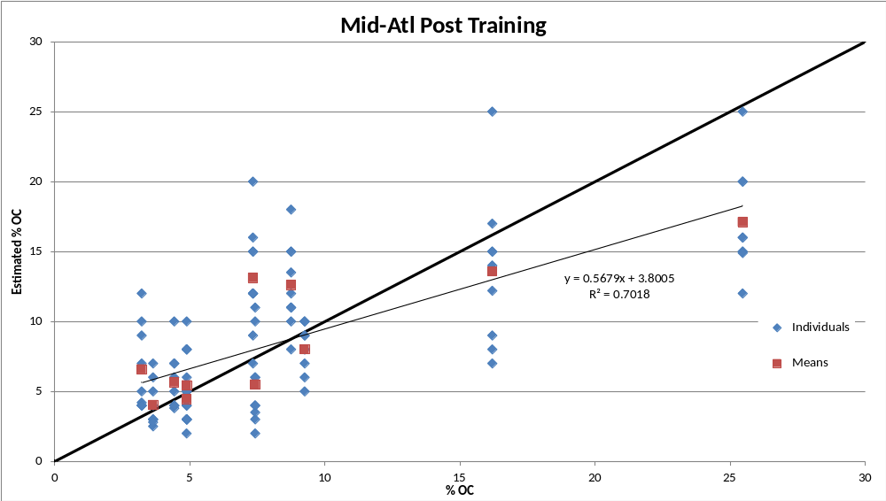

Slide 8
Mid-Atlantic Class Assignment Results
Participant | A | B | C | D | E | F | G | H | I | average correct
Pretraining Correct | 45% | 55% | 36% | 45% | 73% | 64% | 64% | 45% | 73% | 56%
Aftertraining Correct | 73% | 55% | 45% | 55% | 73% | 91% | 82% | 64% | 82% | 69%
Individual Improvement | 27% | 0% | 9% | 9% | 0% | 27% | 18% | 18% | 9%

Slide 9
Summary
Not easy to estimate SOC and determine between mucky modified and mineral or organic soil materials
Without training New England folks could only assign the correct class on average 41% of the time.
Training improved our ability to assign the correct class (68%). This was essentially the same amount as the Mid-Atlantic committee got correct after training (69%)
In general we over-estimate SOC in mineral soil materials and under-estimate SOC in organic soil materials.

